Slide 1
Chapter 5
PROBLEM SOLVING

Slide 2
OUTLINE
Problem Solving Agents
  Steps with Agent Program
  Problem Formulation with Vacuum world, 8 puzzle, 8- queens, Water Jug
Search Strategies
  Uninformed Search Techniques
    Depth First Search
    Breadth First Search
    Uniform Cost Search
    Iterative Search methods
  Informed Search Methods
    Best First Search
    Heuristic Functions
    Hill Climbing
    A*
    IDA*

Slide 3
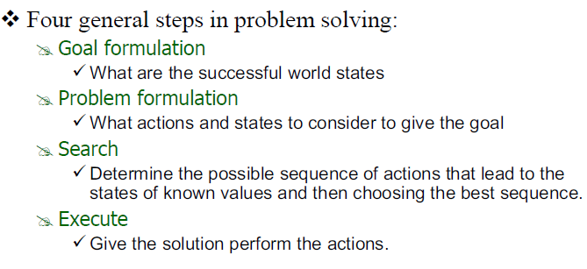
Problem Solving Agent
Based on current situation & performance measure

Slide 4
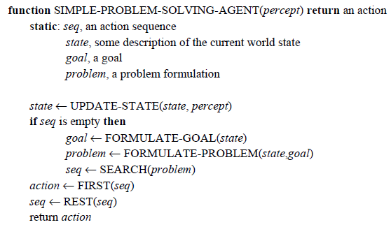
Problem Solving Agent
It first formulates a goal and a problem, searches for a sequence of actions that would
solve the problem, and then executes the actions one at a time. Then it formulates next goal

Slide 5
Problem Solving Agent
The agent design assumes that the environment is Static, because formulating and solving the problem is done without paying attention to any changes that might be occurring in the environment.
The agent design also assumes that the initial state is known; knowing it is easiest if the environment is observable.
The idea of enumerating : “alternative courses of action” assumes that the environment can be viewed as discrete.
Finally, and most importantly, the agent design assumes that the environment is deterministic.

Slide 6
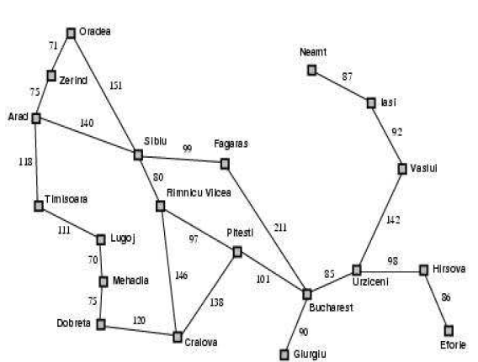
Example : Romania

Slide 7
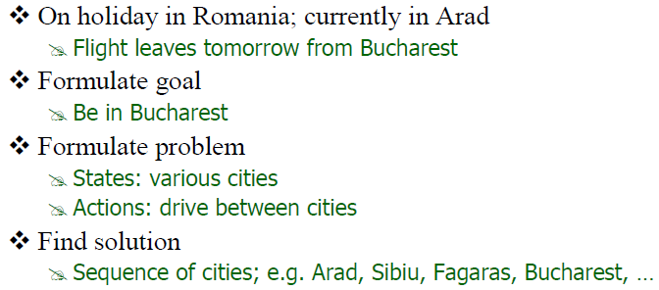
Example : Romania
Current State
Goal
Action , States
Takes problem as input & returns a solution in the form of action sequence

Slide 8
Problem Formulation
What are the components of problem formulation? Hence formulate for vacuum cleaner and 8 puzzle game. DEC 2010. (10 marks)
The initial state that the agent starts in.
  E.g. In(Arad)
Formulation uses a Successor Function: S(X)=Set of Action-State pair.
  E.g. S(Arad)={In(Arad)} -> {Go(sibiu),In(sibiu)}
State Space is Set of all states reachable from the initial state.
  Given as: initial state +successor function=State Space
  S(Arad)={In(Arad)} -> {Go(sibiu),In(sibiu)}
  S(Arad)={In(Arad)} -> {Go(Ti misoara),In(Ti misoara)}
  S(Arad)={In(Arad)} -> {Go(Zerind),In(Zerind)}
A Path in the state space is a sequence of states connected by a sequence of actions.
  S(Arad)={In(Arad)} -> {Go(sibiu),In(sibiu)},
  {In(sibiu)} -> {Go(Fagaras),) In(Fagaras)}
A Solution is a sequence of actions from initial to goal state. Optimal Solution has the lowest path cost.

Slide 9
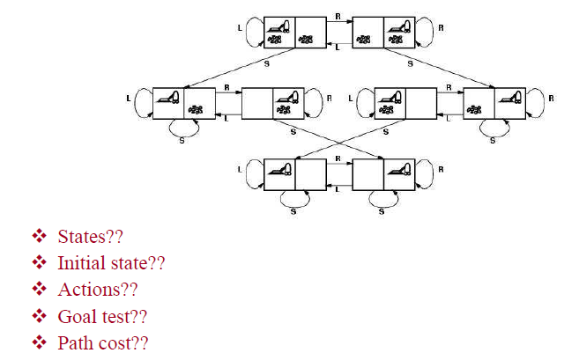
Example 1: Vacuum World

Slide 10
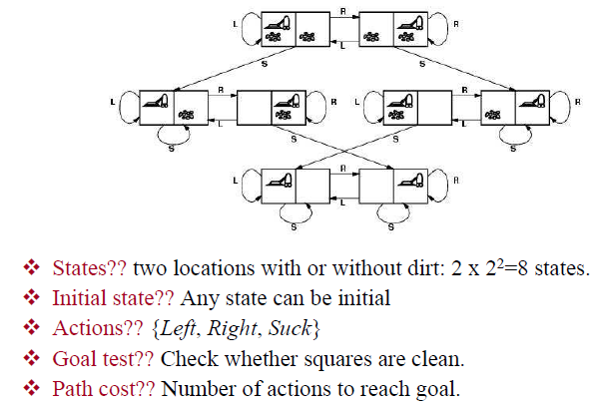
Example 1: Vacuum World
Suppose if Each step costs 1, so the path cost is the no. of steps in the path

Slide 11
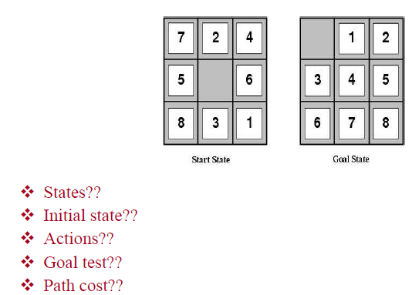
Example 2:
8-Puzzle
An 8 Puzzle consists of 3x3 board with eight numbered tiles and a blank space. A tile adjacent to the blank space can slide into space. The object is to reach specified goal state.

Slide 12
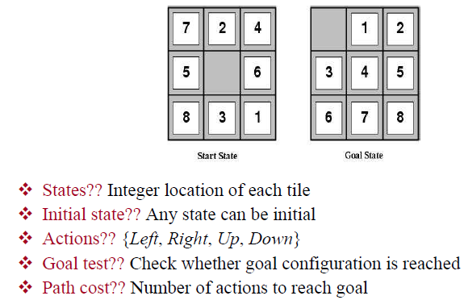
Example 2: 8-Puzzle (Exp-8)
Location of each of the eight tiles and blank is one of nine squares
Suppose if Each step costs 1, so the path cost is the no. of steps in the path

Slide 13
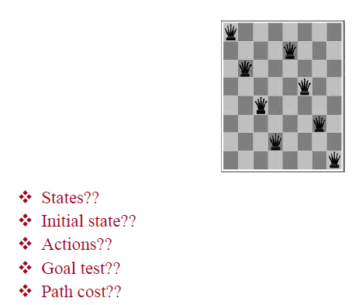
Example 3: 8 Queens Problem (Exp-7)
8 Queens belongs to the family of Sliding-block puzzle. The goal of 8 queen is to place eight queens on a chessboard such that no queen attacks any other.(A queen attacks any piece in the same row, column or diagonal)

Slide 14
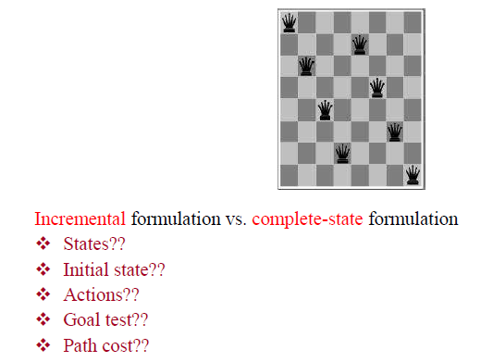
Example 3: 8 Queens Problem
Incremental involves operators that augment
the state description, starting with an empty state: each action adds a queen to the state.
Starts with all 8 queens on the board and moves them around.

Slide 15
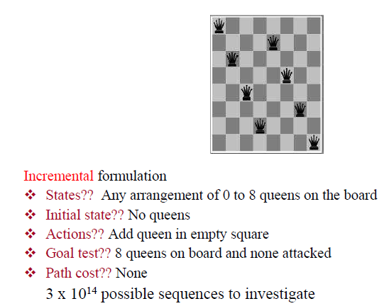
Example 3: 8 Queens Problem
Incremental involves operators that augment
the state description, starting with an empty state: each action adds a queen to the state.
Path cost is of no interest because only final state counts
We have 64*63*62…57 possible combinations i.e. 3x 10 ¹⁴

Slide 16
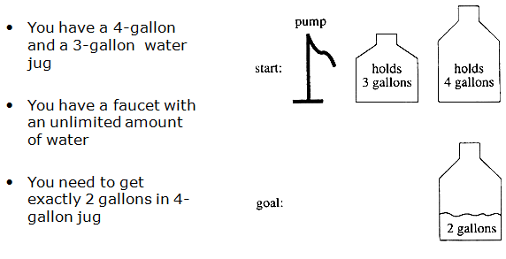
Example 4: A Water Jug Problem (Exp-9)

Slide 17
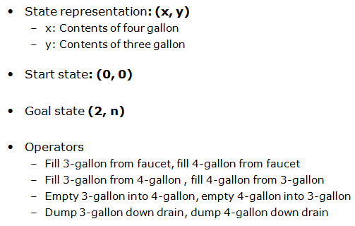
Example 4: A Water Jug Problem (Exp-9)
Puzzle Solving as search

Slide 18
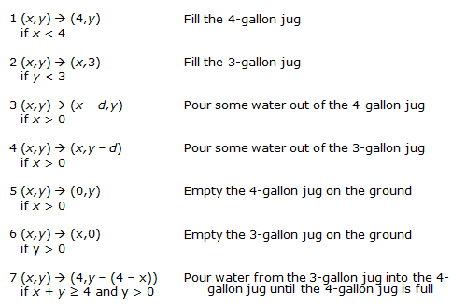
Example 4: A Water Jug Problem (Exp-9)
Production Rules for water jug Problem

Slide 19
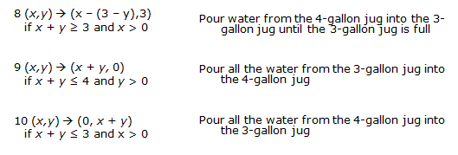
Example 4: A Water Jug Problem (Exp-9)
Production Rules for water jug Problem

Slide 20
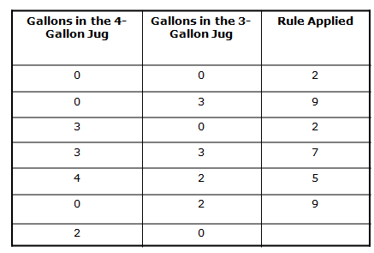
Example 4: A Water Jug Problem (Exp-9)
One Solution for water jug Problem

Slide 21
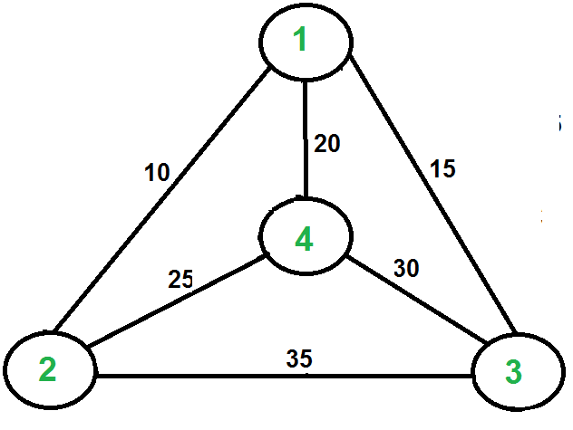
Example 5: The Travelling Salesman Problem
The Travelling Salesman Problem- Is a touring problem in which each city must be visited exactly once. The aim to find the shortest tour.
“Given a set of cities and the distance between each possible pair, the Travelling Salesman Problem is to find the best possible way of ‘visiting all the cities exactly once and returning to the starting point’

Slide 22
Example 5: The Travelling Salesman Problem
Nearest neighbour heuristic:
1. Arbitrarily Select a starting city.
2. To Select the next city, look at all the cities not yet visited and select the one closest to the current city. Go to that city.
3. Repeat step 2 until all cities have been visited.
A TSP tour in the graph is 1-2-4-3-1.
The cost of the tour is 10+25+30+15
which is 80.

Slide 23
Search Strategies
Requirements of a good search strategy:
1. It causes motion
Otherwise, it will never lead to a solution.
2. It is systematic
Otherwise, it may use more steps than necessary.
3. It is efficient
Find a good, but not necessarily the best, answer.

Slide 24
Search Strategies
UNINFORMED/ BLIND SEARCH-
  Search strategies use only the information available in the problem definition.
  Having No Information About The Number Of Steps From The Current State To The Goal.
INFORMED/ HEURISTIC SEARCH -
  When Strategies Can Determine Whether One Non-goal State Is Better Than Another
  More efficient than uninformed search

Slide 25
Uninformed search strategies
Uninformed: While searching you have no clue whether one non-goal state is better than any other. Your search is blind.
Various blind strategies:
  Breadth-first search
  Uniform-cost search
  Depth-first search
  Depth Limited Search
  Iterative deepening search

Slide 26

1. Breadth-first search
Expand shallowest unexpanded node
Implementation:
  Fringe is a first-in-first-out (FIFO) queue, i.e., new successors go at end of the queue.
Is A a goal state?

Slide 27

1. Breadth-first search
Expand shallowest unexpanded node
Implementation:
  Fringe is a FIFO queue, i.e., new successors go at end
Expand:
fringe = [B,C]
Is B a goal state?

Slide 28

1. Breadth-first search
Expand shallowest unexpanded node
Implementation:
  fringe is a FIFO queue, i.e., new successors go at end
Expand:
fringe=[C,D,E]
Is C a goal state?

Slide 29

1. Breadth-first search
Expand shallowest unexpanded node
Implementation:
  fringe is a FIFO queue, i.e., new successors go at end
Expand:
fringe=[D,E,F,G]
Is D a goal state?
Yes

Slide 30
Properties of breadth-first search
Complete? Yes it always reaches goal (if b is finite)
Time? 1+b+b²+b³+… +b^{d} + (b^{d+1}-b)) = O(b^{d+1})
(this is the number of nodes we generate)
Space? O(b^{d+1}) (keeps every node in memory, either in fringe or on a path to fringe).
Optimal? Yes (if we guarantee that deeper solutions are less optimal, e.g. step-cost=1).
Space is the bigger problem (more than time)

Slide 31
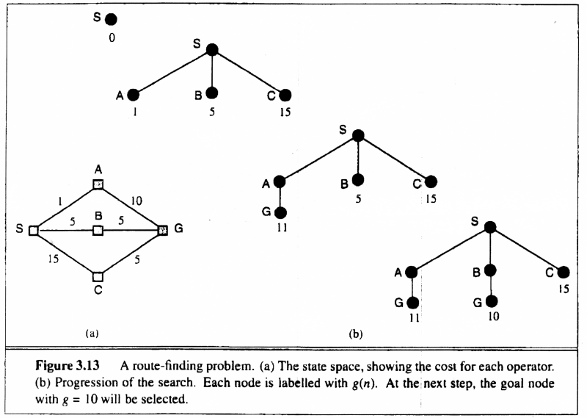
2. Uniform-cost search
Note: If all step costs are equal, this is identical to breadth First Search
Implementation:
Strategy to select state to expand next Node
Use the state with the smallest value of g() so far from the root
Use priority queue for efficient access to minimum g at every iteration

Slide 32
2. Uniform-cost search
Implementation: fringe = queue ordered by path cost
Equivalent to breadth-first if all step costs all equal.
Complete? Yes, if step cost ≥ ε
(otherwise it can get stuck in infinite loops)
Time? # of nodes with path cost ≤ cost of optimal solution.
Space? # of nodes on paths with path cost ≤ cost of optimal
solution.
Optimal? Yes, for any step cost.

Slide 33

3. Depth-first search
Expand deepest unexpanded node
Implementation:
  fringe = Last In First Out (LIPO) queue, i.e., put successors at front
Is A a goal state?

Slide 34

3. Depth-first search
Expand deepest unexpanded node
Implementation:
  fringe = LIFO queue, i.e., put successors at front
queue=[B,C]
Is B a goal state?

Slide 35

3. Depth-first search
Expand deepest unexpanded node
Implementation:
  fringe = LIFO queue, i.e., put successors at front
queue=[D,E,C]
Is D = goal state?

Slide 36

3. Depth-first search
Expand deepest unexpanded node
Implementation:
  fringe = LIFO queue, i.e., put successors at front
queue=[H,I,E,C]
Is H = goal state?

Slide 37

3. Depth-first search
Expand deepest unexpanded node
Implementation:
  fringe = LIFO queue, i.e., put successors at front
queue=[I,E,C]
Is I = goal state?

Slide 38

3. Depth-first search
Expand deepest unexpanded node
Implementation:
  fringe = LIFO queue, i.e., put successors at front
queue=[E,C]
Is E = goal state?

Slide 39

3. Depth-first search
Expand deepest unexpanded node
Implementation:
  fringe = LIFO queue, i.e., put successors at front
queue=[J,K,C]
Is J = goal state?

Slide 40

3. Depth-first search
Expand deepest unexpanded node
Implementation:
  fringe = LIFO queue, i.e., put successors at front
queue=[K,C]
Is K = goal state?

Slide 41

3. Depth-first search
Expand deepest unexpanded node
Implementation:
  fringe = LIFO queue, i.e., put successors at front
queue=[C]
Is C = goal state?

Slide 42

3. Depth-first search
Expand deepest unexpanded node
Implementation:
  fringe = LIFO queue, i.e., put successors at front
queue=[F,G]
Is F = goal state?

Slide 43

3. Depth-first search
Expand deepest unexpanded node
Implementation:
  fringe = LIFO queue, i.e., put successors at front
queue=[L,M,G]
Is L = goal state?

Slide 44

3. Depth-first search
Expand deepest unexpanded node
Implementation:
  fringe = LIFO queue, i.e., put successors at front
queue=[M,G]
Is M = goal state?
Yes

Slide 45
3. Properties of depth-first search
Complete? No: fails in infinite-depth spaces
Can modify to avoid repeated states along path
Time? O(b^{m}) with m=maximum depth
terrible if m is much larger than d
  but if solutions are dense, may be much faster than
  breadth-first
Space? O(bm), i.e., linear space! (we only need to
remember a single path + expanded unexplored nodes)
Optimal? No (It may find a non-optimal goal first)

Slide 46
4. Depth Limited Search
To avoid the infinite depth problem of DFS, we can decide to only search until depth L, i.e. we don’t expand beyond depth L.
→ Depth-Limited Search = Depth first Search with depth limited l (i.e. node at depth l have no successors)

Slide 47
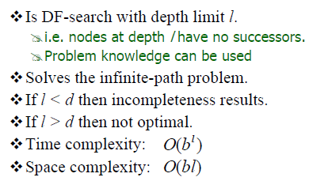
4. Properties of depth-Limited search

Slide 48
5. Iterative Deepening Search- DFS with increasing depth limit
What of solution is deeper than L? → Increase L iteratively.
→ Iterative Deepening Search
• Finds the best depth limit
  Combines the benefits of DFS and BFS. As we shall see: this inherits the memory advantage of Depth-First search.

Slide 49

Iterative deepening search L=0

Slide 50

Iterative deepening search L=1

Slide 51

Iterative deepening search lL=2

Slide 52

Iterative deepening search lL=3

Slide 53
5. Properties of Iterative deepening search
Complete? Yes
Time? (d+1)b⁰ + d b¹ + (d-1)b² + … + b^{d} = O(b^{d})
Space? O(bd)
Optimal? Yes, if step cost = 1 or increasing function of depth.

Slide 54

Summary of algorithms

Slide 55
University Asked Questions on Uninformed
Compare and contrast BFS and DFS. And explain the search strategy developed to overcome the drawback of both. (DEC 2010)
Explain Depth First Search with example. (DEC 2012)
Compare different Uninformed Search Techniques. (JUNE 2011, JUNE 2013)

Slide 56
Informed search strategies
Informed: When Strategies Can Determine Whether One Non-goal State Is Better Than Another.
  More efficient than uninformed search.
Various Heuristic strategies:
  Best First Search
  Generate and Test
  Hill Climbing Search
  A*
  IDA*

Slide 57
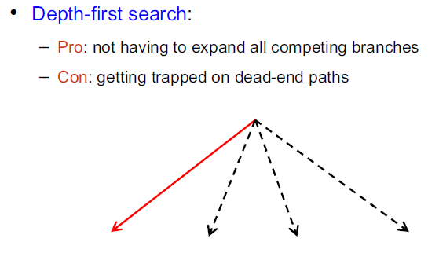
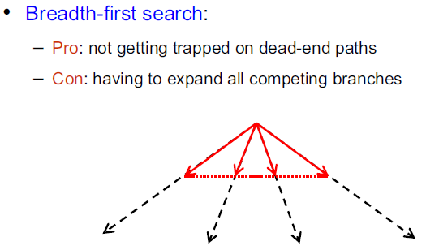
1. Best First Search

Slide 58
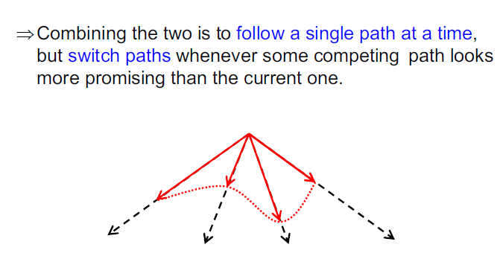
1. Best First Search

Slide 59
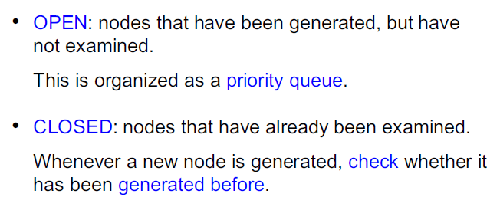
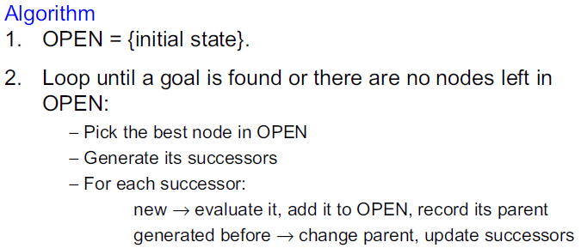
1. Best First Search

Slide 60
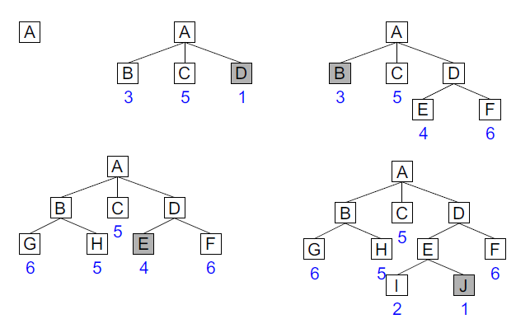
1. Best First Search-Example
Best-first search is an instance of the general TREE-SEARCH or GRAPH-SEARCH algorithm in which a node is EVALUATION FUNCTION selected for expansion based on an evaluation function, f (n) .
Traditionally, the node with the lowest evaluation is selected for expansion, because the evaluation measures distance to the goal.

Slide 61
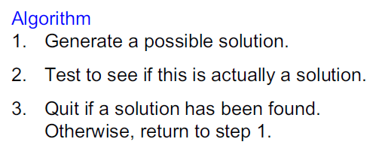
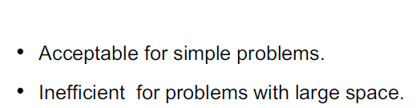
2. Generate and Test
Advantage & Disadvantage:

Slide 62
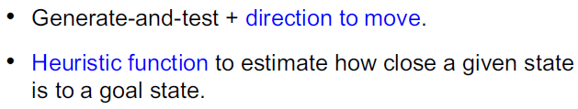
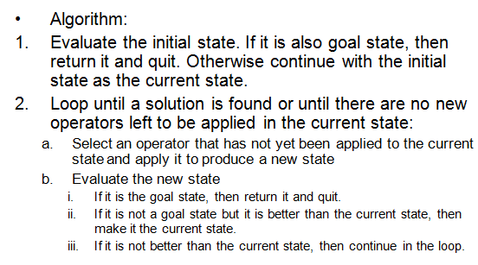
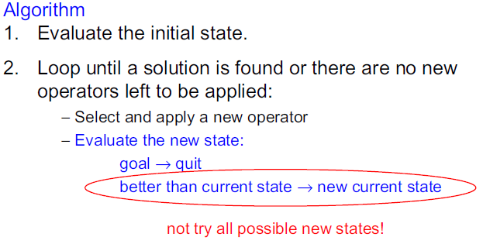
3. Hill-climbing search

Slide 63
Example: 8 Puzzle
1
2
3
1
2
3
7
8
4
8
4
6
5
7
6
5
Initial State
Goal State

Slide 64
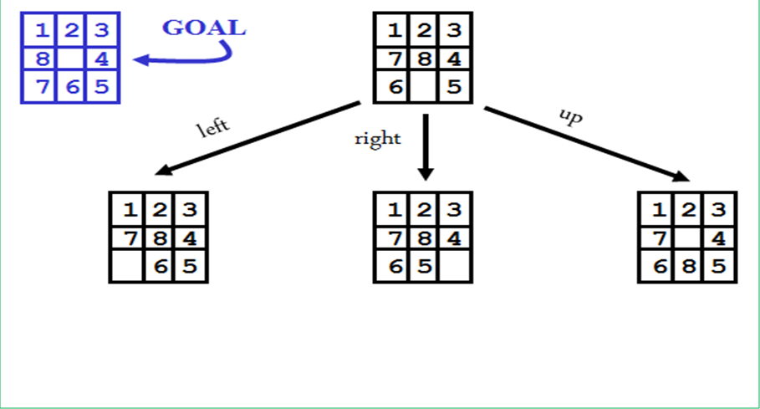
Hill climbing example
h=3
down
h=2
h=4
h=3

Slide 65
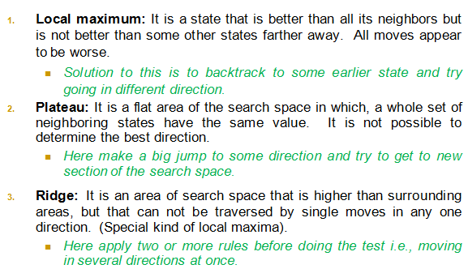
Problems in Hill Climbing
Sequence Of Local Maxima Difficult For Greedy Algorithms To Navigate

Slide 66
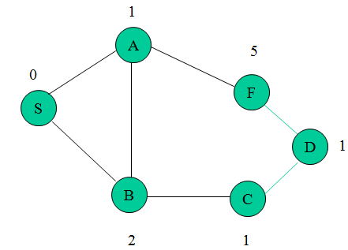
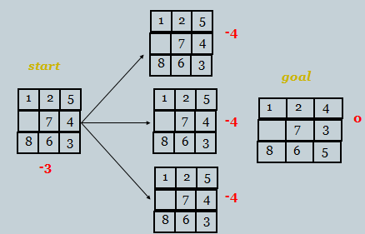
Example of a Local Maximum
Problems in Hill Climbing
Example of a Plateau

Slide 67
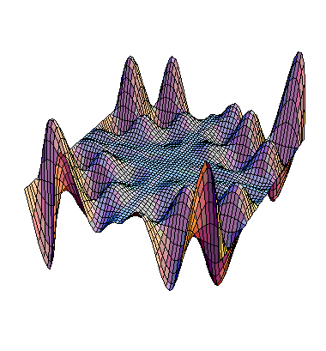
Exploring the Landscape
Local Maxima: peaks that aren’t the highest point in the space
Plateaus: the space has a broad flat region that gives the search algorithm no direction (random walk)
Ridges: flat like a plateau, but with drop-offs to the sides; steps to the North, East, South and West may go down, but a step to the NW may go up.
Local Maximum
Plateau
Ridge

Slide 68

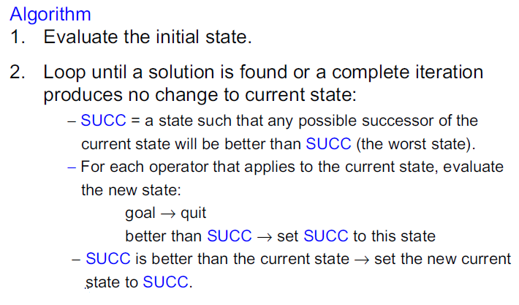
Steepest-Ascent Hill Climbing-(Gradient Search)

Slide 69
Hill climbing example
2
8
3
1
2
3
start
1
6
4
h = 4
goal
8
4
h = 0
7
5
7
6
5
5
5
2
2
8
3
1
2
3
1
4
h = 3
8
4
h = 1
7
6
5
7
6
5
3
4
2
3
2
3
1
8
4
1
8
4
h = 2
7
6
5
7
6
5
h = 3
4
f(n) = (number of tiles out of place)

Slide 70
(Exp-10)- 8 Puzzle Problem using Steepest-Ascent Hill Climbing
Aim: To implement 8 Puzzle Problem
Theory: 1. Problem Formulation for it
2. Steepest-Ascent Hill Climbing Algorithm
3. Solve the problem.
Conclusion: Thus , We have studied and implemented the 8 puzzle problem using Steepest-Ascent Hill Climbing Algorithm.

Slide 71
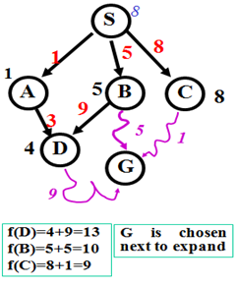
Algorithm A
A is the most widely known form of Best-First search
  It evaluates nodes by combining g(n) and h(n)
  f(n) = g(n) + h(n)
g(n) = cost from the initial state to the current state n
h(n) = estimated cost of the cheapest path from node n to a goal node
f(n) = evaluation function to select a node for expansion (usually the lowest cost node)

Slide 72
Algorithm A*
Algorithm A with constraint that h(n) <= h*(n)
h*(n) = true cost of the minimal cost path from n to any goal.
g*(n) = true cost of the minimal cost path from S to n.
f*(n) = h*(n)+g*(n) = true cost of the minimal cost solution path from S to any goal going through n.
Property of A* Algorithm:
  h is admissible when h(n) <= h*(n) holds. Using an admissible heuristic guarantees that the first solution found will be an optimal one. Therefore, A* is admissible.
  A* is complete whenever the branching factor is finite.

Slide 73
Algorithm A*
Start with OPEN containing only initial node.
  Set that node’s g value to 0, its h’ value to whatever it is, and its f’ value to h’+0 or h’. Set CLOSED to empty list.
Until a goal node is found, repeat the following procedure:
  If there are no nodes on OPEN, report failure.
  Otherwise pick the node on OPEN with the lowest f’ value. Call it BESTNODE. Remove it from OPEN. Place it in CLOSED. See if the BESTNODE is a goal state. If so exit and report a solution.
  Otherwise, generate the successors of BESTNODE but do not set the BESTNODE to point to them yet.

Slide 74
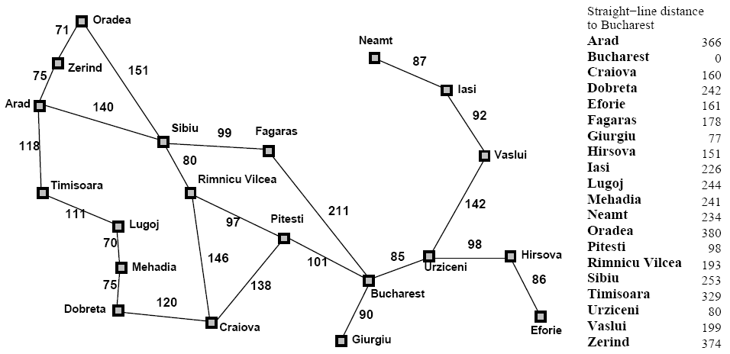
A* Search
AI: Chapter 4: Informed Search and Exploration
January 31, 2006

Slide 75
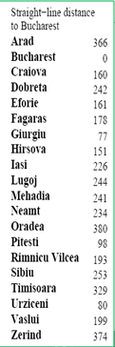

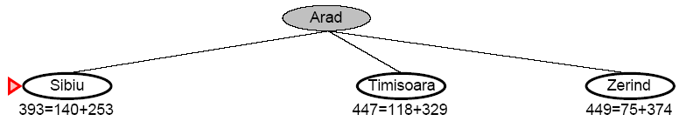
A* Search
AI: Chapter 4: Informed Search and Exploration
January 31, 2006

Slide 76
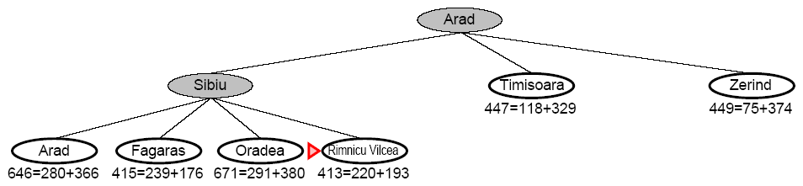
A* Search
AI: Chapter 4: Informed Search and Exploration
January 31, 2006

Slide 77
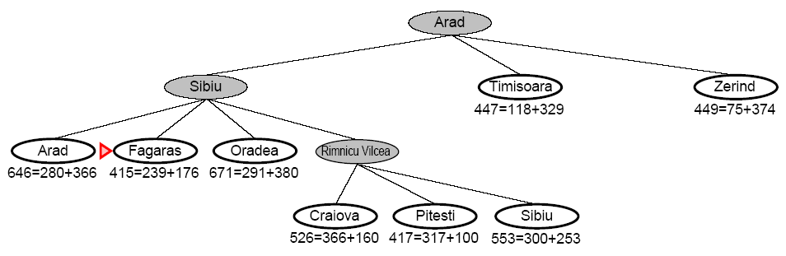
A* Search
AI: Chapter 4: Informed Search and Exploration
January 31, 2006

Slide 78
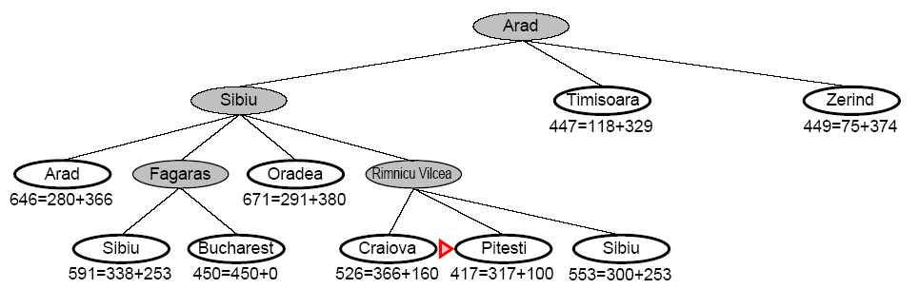
A* Search
AI: Chapter 4: Informed Search and Exploration
January 31, 2006

Slide 79
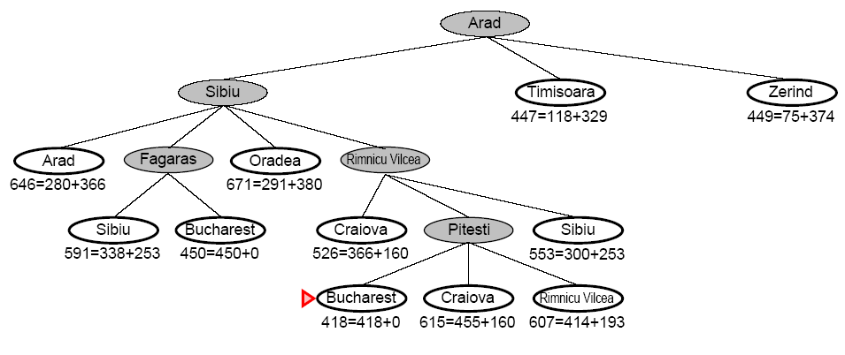
A* Search
AI: Chapter 4: Informed Search and Exploration
January 31, 2006

Slide 80
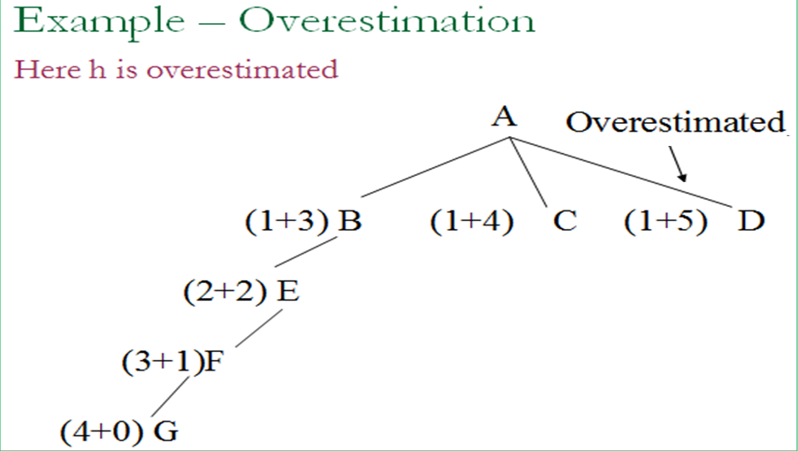
Behavior of A*- Overestimation

Slide 81
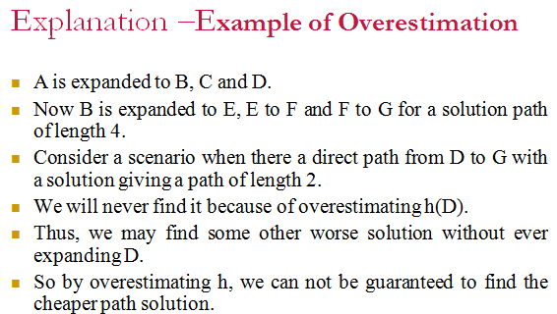

Slide 82
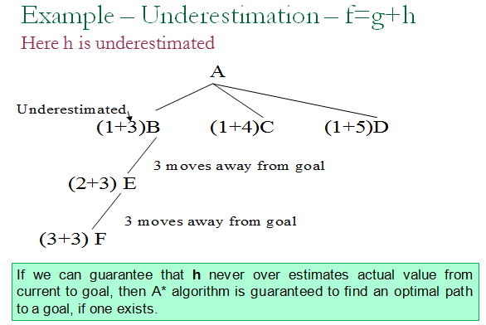
Behavior of A*- Underestimation

Slide 83
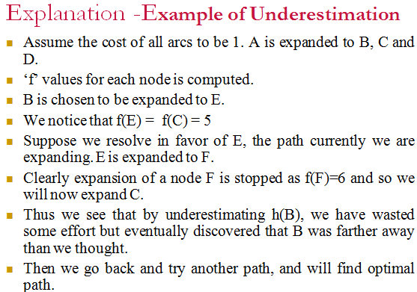

Slide 84
Admissibility of A*
A search algorithm is admissible, if
  for any graph, it always terminates in an optimal path from initial state to goal state, if path exists.
If heuristic function h is underestimate of actual value from current state to goal state, then it is called admissible function.
Alternatively we can say that A* always terminates with the optimal path in case
  h(x) is an admissible heuristic function.

Slide 85
Monotonicity of A*
A heuristic function h is monotone if
  ∀ states Xi and Xj such that Xj is successor of Xi
h(Xi)– h(Xj) ≤ cost (Xi, Xj) where, cost (Xi, Xj) actual cost of going from Xi to Xj
Example: h(Xi): Arad to Bucharest=366
h(Xj): Sibiu to Bucharest=253
h(Xi)– h(Xj):366-253=113
cost (Xi, Xj): Arad to Sibiu=140
  h (goal) = 0
In this case, heuristic is locally admissible i.e., consistently finds the minimal path to each state they encounter in the search.
Each monotonic heuristic is admissible
  A cost function f(n) is monotone. if f(n) ≤ f(succ(n)), ∀n.

Slide 86
Contd..
Alternatively, the monotone property:
  that search space which is every where locally consistent with heuristic function employed i.e., reaching each state along the shortest path from its ancestors.
With monotonic heuristic, if a state is rediscovered, it is not necessary to check whether the new path is shorter.
Each monotonic heuristic is admissible
  A cost function f(n) is monotone. if f(n) ≤f(succ(n)), ∀n.
For any admissible cost function f, we can construct a monotone admissible function.

Slide 87
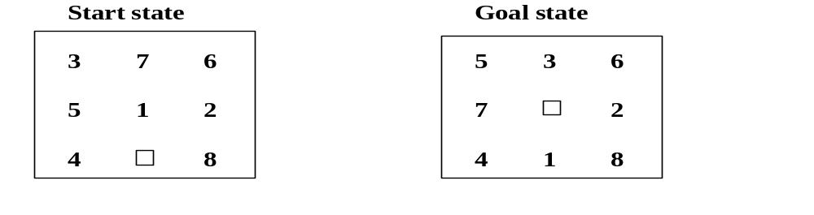
Example: Solve Eight puzzle problem using A* algorithm
Evaluation function f (X) = g (X) + h(X)
h (X) = the number of tiles not in their goal position in a given state X
g(X) = depth of node X in the search tree
Initial node has f(initial_node) = 4
Apply A* algorithm to solve it.
The choice of evaluation function critically determines search results.

Slide 88
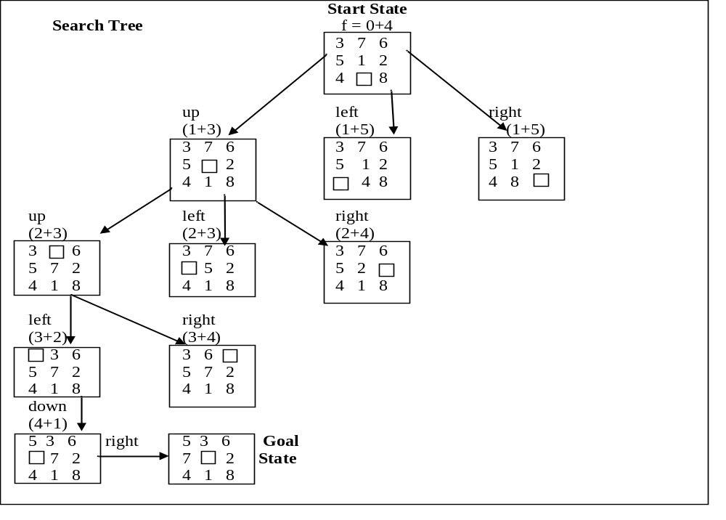


Slide 89
Harder Problem- Solved by Manhattan distance
Harder problems (8 puzzle) can’t be solved by heuristic function defined earlier.
Initial State Goal State
1 6 1 2 3
4 8 8 4
7 5 3 7 6 5
A better estimate function is to be thought.
h (X) = the sum of the distances of the tiles from their goal position in a given state X
Initial node has h(initial_node) = 1+1+2+2+1+3+0+2=12

Slide 90
A* Weaknesses
Still requires the use of a “natural” distance measure
Sorting takes time
Removing paths takes time

Slide 91
IDA*- the basis of “state of the art” “complete & optimal” algorithms
Combine A* and iterative deepening
f is the estimate of total path cost for start to goal
IDA*:
  Impose a limit on f
  Use DFS to search within the f limit
  Iteratively relax the limit
Greatly reduces memory usage
Can repeat far too much work, and so be slow

Slide 92

f-values form relief
IDA*: Repeat depth-first within f-limit increasing: f0, f1, f2, f3, ...

Slide 93
IDA* Algorithm
Bound := f(StartNode);
SolutionFound := false; //If Solution not found
Repeat
perform depth-first search from StartNode, so that
a node N is expanded only if f(N) ≤ Bound; //if successor node f(n) value less
if this depth-first search encounters a goal node with f ≤ Bound
then SolutionFound = true
else
compute new bound as:
Bound = min { f(N) | N generated by this search, f(N) > Bound }
until solution found.

Slide 94
Backtracking
Backtracking is kind of solving a problem by trial and error.
However, it is a well organized trial and error. We make sure that we never try the same thing twice. We also make sure that if the problem is finite we will eventually try all possibilities (assuming there is enough computing power to try all possibilities).

Slide 95



EXP-9: Implementation of 8-queen Problem

Slide 96


Solution to N Queens Problem

Slide 97
N queens Solution using Backtracking
Basic idea of solution:
  Start with one queen in the first column, first row.
  Start with another queen in the second column, first row.
  Go down with the second queen until you reach a permissible situation.
  Advance to the next column, first row, and do the same thing.
  If you cannot find a permissible situation in one column and reach the bottom of it, then you have to go back to the previous column and move one position down there.(This is the backtracking step.)
  If you reach a permissible situation in the last column of the board, then the problem is solved.
  If you have to backtrack BEFORE the first column, then the problem is not solvable

Slide 98
Example: 4-Queens Problem
X1
{1,2,3,4}
X2
{1,2,3,4}
1
2
3
4
1
2
3
4
X3
{1,2,3,4}
X4
{1,2,3,4}
CIS 391 - Intro to AI

Slide 99
Example: 4-Queens Problem
X1
{1,2,3,4}
X2
{1,2,3,4}
1
2
3
4
1
2
3
4
X3
{1,2,3,4}
X4
{1,2,3,4}
CIS 391 - Intro to AI

Slide 100
Example: 4-Queens Problem
X1
{1,2,3,4}
X2
{ , ,3,4}
1
2
3
4
1
2
3
4
X3
{ ,2, ,4}
X4
{ ,2,3, }
CIS 391 - Intro to AI

Slide 101
Example: 4-Queens Problem
X1
{1,2,3,4}
X2
{ , ,3,4}
1
2
3
4
1
2
3
4
X3
{ ,2, ,4}
X4
{ ,2,3, }
CIS 391 - Intro to AI

Slide 102
Example: 4-Queens Problem
X1
{1,2,3,4}
X2
{ , ,3,4}
1
2
3
4
1
2
3
4
X3
{ , , , }
X4
{ ,2,3, }
Backtrack!!!
CIS 391 - Intro to AI

Slide 103
Example: 4-Queens Problem
X1
{ ,2,3,4}
X2
{1,2,3,4}
1
2
3
4
1
2
3
4
X3
{1,2,3,4}
X4
{1,2,3,4}
CIS 391 - Intro to AI

Slide 104
Example: 4-Queens Problem
X1
{ ,2,3,4}
X2
{ , , ,4}
1
2
3
4
1
2
3
4
X3
{1, ,3, }
X4
{1, ,3,4}
CIS 391 - Intro to AI

Slide 105
Example: 4-Queens Problem
X1
{ ,2,3,4}
X2
{ , , ,4}
1
2
3
4
1
2
3
4
X3
{1, ,3, }
X4
{1, ,3,4}
CIS 391 - Intro to AI

Slide 106
Example: 4-Queens Problem
X1
{ ,2,3,4}
X2
{ , , ,4}
1
2
3
4
1
2
3
4
X3
{1, , , }
X4
{1, ,3, }
CIS 391 - Intro to AI

Slide 107
Example: 4-Queens Problem
X1
{ ,2,3,4}
X2
{ , , ,4}
1
2
3
4
1
2
3
4
X3
{1, , , }
X4
{1, ,3, }
CIS 391 - Intro to AI

Slide 108
Example: 4-Queens Problem
X1
{ ,2,3,4}
X2
{ , , ,4}
1
2
3
4
1
2
3
4
X3
{1, , , }
X4
{ , ,3, }
CIS 391 - Intro to AI

Slide 109


4-Queen Solution Using Backtracking

Slide 110

For 8 queen- 92 solutions exists( display at least 4 solutions)
For 4 queen - 2 Solution exists
The program is long and complicated. It certainly does not fit onto one screen. It moves from one row to the next row with a while loop. However, it moves from one column to the next column by recursion.

Slide 111
Constraint Satisfaction Problem
Set of variables {X₁, X₂, …, X_{n}}
Each variable Xi has a domain D_{i} of possible values
  Usually D_{i} is discrete and finite
Set of constraints {C₁, C₂, …, C_{p}}
  Each constraint C_{k} involves a subset of variables and specifies the allowable combinations of values of these variables
Goal: Assign a value to every variable such that all constraints are satisfied

Slide 112

CSP example: Map coloring
Variables: WA, NT, Q, NSW, V, SA, T
Domains: D_{i}={red, green, blue}
Constraints: adjacent regions must have different colors.
    E.g. WA ≠ NT (Should not have the same color)

Slide 113

CSP example: map coloring
Solutions are assignments satisfying all constraints, e.g.
{WA=red, NT=green, Q=red, NSW=green, V=red, SA= blue, T=green}

Slide 114
Backtracking search for CSP
Similar to Depth-first search
Chooses values for one variable at a time and backtracks when a variable has no legal values left to assign.
Uninformed algorithm
  No good general performance

Slide 115
Backtracking Search
CSP-BACKTRACKING({})
CSP-BACKTRACKING(a)
  If a is complete then return a
  X ← select unassigned variable
  D ← select an ordering for the domain of X
  For each value v in D do
    If v is consistent with a then
      Add (X= v) to a
      result ← CSP-BACKTRACKING(a)
      If result ≠ failure then return result
  Return failure

Slide 116
→ Backtracking Search
empty assignment
1st variable
2nd variable
3rd variable
Assignment = {}

Slide 117
→ Backtracking Search
empty assignment
1st variable
2nd variable
3rd variable
Assignment = {(var1=v11)}

Slide 118
→ Backtracking Search
empty assignment
1st variable
2nd variable
3rd variable
Assignment = {(var1=v11),(var2=v21)}

Slide 119
→ Backtracking Search
empty assignment
1st variable
2nd variable
3rd variable
Assignment = {(var1=v11),(var2=v21),(var3=v31)}

Slide 120
→ Backtracking Search
empty assignment
1st variable
2nd variable
3rd variable
Assignment = {(var1=v11),(var2=v21),(var3=v32)}

Slide 121
→ Backtracking Search
empty assignment
1st variable
2nd variable
3rd variable
Assignment = {(var1=v11),(var2=v22)}

Slide 122
→ Backtracking Search
empty assignment
1st variable
2nd variable
3rd variable
Assignment = {(var1=v11),(var2=v22),(var3=v31)}

Slide 123
Map Coloring
{}
WA=red
WA=green
WA=blue
WA=red
NT=green
WA=red
NT=blue
NT
Q
WA
WA=red
NT=green
Q=red
WA=red
NT=green
Q=blue
SA
NSW
V
T

Slide 124

Backtracking Map Color example

Slide 125

Crypt-Arithmetic puzzle
Write short note on Crypt Arithmetic? (JUNE 2011, 2013)
Problem Statement:
  Solve the following puzzle by assigning numeral (0-9) in such a way that each letter is assigned unique digit which satisfy the following addition.
  Constraints : No two letters have the same value. (The constraints of arithmetic).
Initial Problem State
  S = ? ; E = ? ;N = ? ; D = ? ; M = ? ;O = ? ; R = ? ;Y = ?

Slide 126

Carries :
    C₄ = ? ; C₃ = ? ; C₂ = ? ; C₁ = ?
Constraint equations:
    Y = D + E C₁
    E = N + R + C₁ C₂
    N = E + O + C₂ C₃
        O = S + M + C₃ C₄
    M = C₄

Slide 127

We can easily see that M has to be non zero digit, so the value of C4 =1
M = C4 ⇒ M = 1
O = S + M + C3 → C4
For C4 =1, S + M + C3 > 9 ⇒
S + 1 + C3 > 9 ⇒ S+C3 > 8.
If C3 = 0, then S = 9 else if C3 = 1,
then S = 8 or 9.
We see that for S = 9
  C3 = 0 or 1
  It can be easily seen that C3 = 1 is not possible as O = S + M + C3 ⇒ O = 11 ⇒ O has to be assigned digit 1 but 1 is already assigned to M, so not possible.
  Therefore, only choice for C3 = 0, and thus O = 10. This implies that O is assigned 0 (zero) digit.
Therefore, O = 0
M = 1, O = 0
    Y = D + E → C1
    E = N + R + C1 → C2
    N = E + O + C2 → C3
    O = S + M + C3 → C4
    M = C4

Slide 128
Since C3 = 0; N = E + O + C2 produces no carry.
As O = 0, N = E + C2 .
Since N ≠ E, therefore, C2 = 1.
Hence N = E + 1
Now E can take value from 2 to 8 {0,1,9 already assigned so far }
  If E = 2, then N = 3.
  Since C2 = 1, from E = N + R + C1 , we get 12 = N + R + C1
    If C1 = 0 then R = 9, which is not possible as we are on the path with S = 9
    If C1 = 1 then R = 8, then
        From Y = D + E , we get 10 + Y= D + 2 .
        For no value of D, we can get Y.
  Try similarly for E = 3,N= 4. We fail in each case.
  Try similarly for E =4, N=5. We fail in each case.
    Y = D + E → C1
    E = N + R + C1 → C2
    N = E + O + C2 → C3
    O = S + M + C3 → C4
    M = C4

Slide 129
If E = 5, then N = 6
  Since C2 = 1, from E = N + R + C1 , we get 15 = N + R + C1 ,
  If C1 = 0 then R = 9, which is not possible as we are on the path with S = 9.
  If C1 = 1 then R = 8, then
    From Y = D + E , we get 10 + Y= D + 5 i.e., 5 + Y = D.
    If Y = 2 then D = 7. These values are possible.
Hence we get the final solution as given below and on backtracking, we may find more solutions.
S = 9 ; E = 5 ; N = 6 ; D = 7 ;
M = 1 ; O = 0 ; R = 8 ;Y = 2
    Y = D + E → C1
    E = N + R + C1 → C2
    N = E + O + C2 → C3
    O = S + M + C3 → C4
    M = C4

Slide 130
University Asked Questions on Informed
Explain Heuristic function with example? (DEC 2011, DEC 2012)
Give and Explain A* Algorithm. Drawbacks of A* and Show that A* is optimally efficient? (DEC 2010, DEC 2011, JUNE 2013)
What do you mean by admissible heuristic search function, explain with example? (DEC 2012)
Give and Explain IDA* Search Algorithm. (DEC 2012, JUNE 2011)
Explain Hill Climbing Algorithm? Give its limitations? (JUNE 2013)

Slide 131
Thank You

